Slide 1
Convolutional Neural Networks (CNNs)
Generated for: Convolutional Neural Networks (CNNs), Introduction to CNNs, Convolution Operation, Pooling Layers, CNN Architecture Example, Applications of CNNs
Notes:
Welcome to the Convolutional Neural Networks (CNNs) presentation covering multiple topics. Today we'll explore: Convolutional Neural Networks (CNNs), Introduction to CNNs, Convolution Operation, Pooling Layers, CNN Architecture Example, Applications of CNNs.

Slide 2

Convolutional Neural Networks (CNNs) - Introduction
CNNs inspired by biological neural networks
Use convolutional and pooling layers
Primarily for image and video processing
Can learn spatial hierarchies of features
Robust to small transformations and distortions
Key applications in computer vision
Image classification and object detection
Segmentation and localization tasks
Used in self-driving cars and robotics
Enable deep learning for visual data
Notes:
When introducing CNNs, emphasize their biological inspiration and ability to learn spatial hierarchies. Explain the role of convolutional and pooling layers in reducing spatial dimensions while retaining important information. Provide examples of key applications, such as image classification, object detection, and segmentation. Ask students to consider how CNNs can be used in real-world scenarios, like self-driving cars and robotics, and what benefits they offer over traditional computer vision techniques. Key takeaways should include understanding the basics of CNN architecture and their versatility in handling visual data.

Slide 3
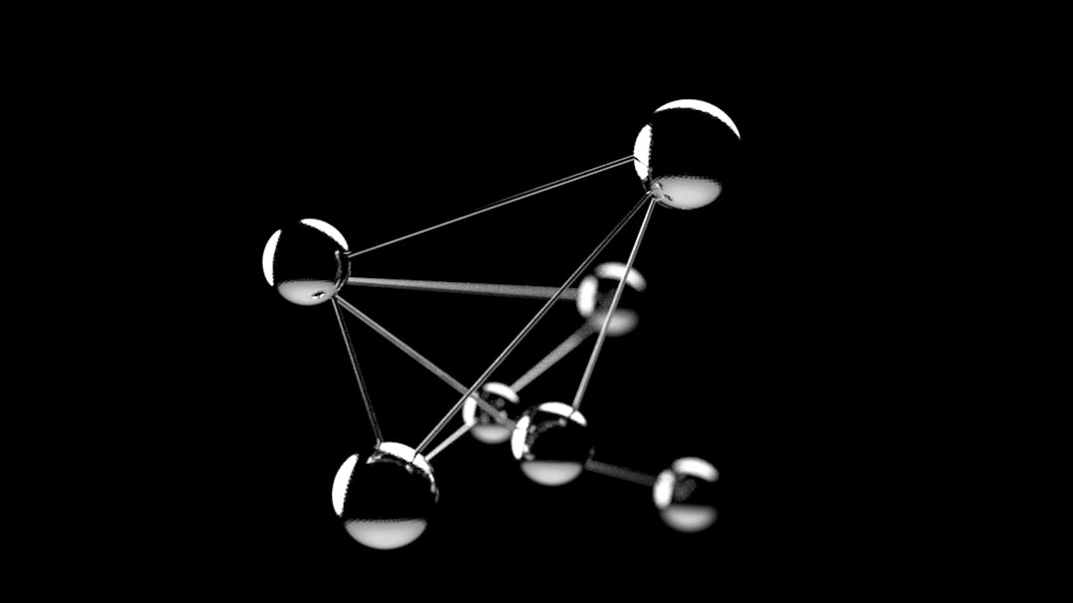
Convolutional Neural Networks (CNNs) - Introduction
CNNs are deep learning models for image classification tasks
Inspired by human visual cortex structure and function
Use convolutional and pooling layers for feature extraction
Automatically learn spatial hierarchies of features
Typically used for object detection and image recognition
Can be applied to signal processing and natural language
Convolutional layers use filters for feature detection
Pooling layers reduce spatial dimensions for efficiency
Fully connected layers for final classification output
Activation functions introduce non-linearity in models
Notes:
When introducing CNNs, explain the biological inspiration behind their architecture and how they are particularly suited for image and signal processing tasks. Provide examples of applications such as self-driving cars, facial recognition, and medical image analysis. Emphasize the importance of convolutional and pooling layers in automatically extracting features from data. Ask students to consider how CNNs differ from fully connected neural networks and what advantages they offer in terms of computational efficiency and ability to handle large datasets. Key takeaways should include understanding the basic components of a CNN and their role in image classification and object detection tasks.

Slide 4
Convolutional Neural Networks (CNNs) - Architecture
CNNs composed of convolutional and pooling layers
Convolutional layers extract local features
Pooling layers reduce spatial dimensions
Fully connected layers for classification
Activation functions introduce non-linearity
ReLU activation function commonly used
Batch normalization improves stability
Dropout prevents overfitting
Convolutional layers use filters
y = σ(Wx + b) simple neural equation
Notes:
When explaining the architecture of CNNs, emphasize the role of convolutional and pooling layers in feature extraction and dimension reduction. Provide examples of how activation functions like ReLU introduce non-linearity, and how batch normalization and dropout are used to improve model stability and prevent overfitting. Ask students to consider how the architecture of a CNN would change for different applications, such as image classification versus object detection. Key takeaways include understanding the basic components of a CNN and how they work together to enable deep learning.

Slide 5
Introduction to CNNs - Introduction
Convolutional Neural Networks (CNNs) analyze visual data
Inspired by human brain's visual cortex structure
Use convolutional and pooling layers
Apply to image classification tasks
Used in self-driving cars and facial recognition
Can learn features from raw data
Automate feature extraction process
Improve performance with large datasets
Require significant computational resources
Notes:
When introducing CNNs, emphasize their ability to analyze visual data and their inspiration from the human brain's visual cortex. Provide examples of applications such as image classification, self-driving cars, and facial recognition. Explain that CNNs can learn features from raw data, automating the feature extraction process, and highlight the importance of large datasets and computational resources. Ask students to consider the potential benefits and challenges of using CNNs in real-world scenarios, and encourage them to think about the ethical implications of these technologies.

